Slide 1
Softcode Hack2.0
Project Title: Internwale

Slide 2
By Team name: codechampions
MadhavaReddy Madathala(Admin)
Chandana Reddy(Member)
Ireddi Rakshitha(Member)
Vasisri Thokala(Member)

Slide 3
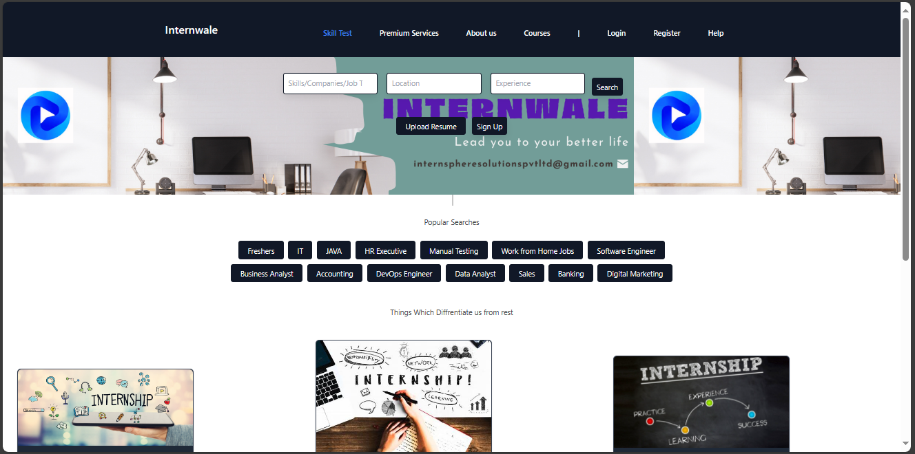
Home page

Slide 4
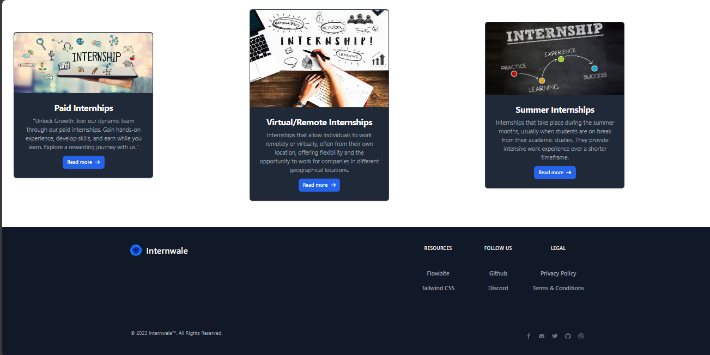

Slide 5
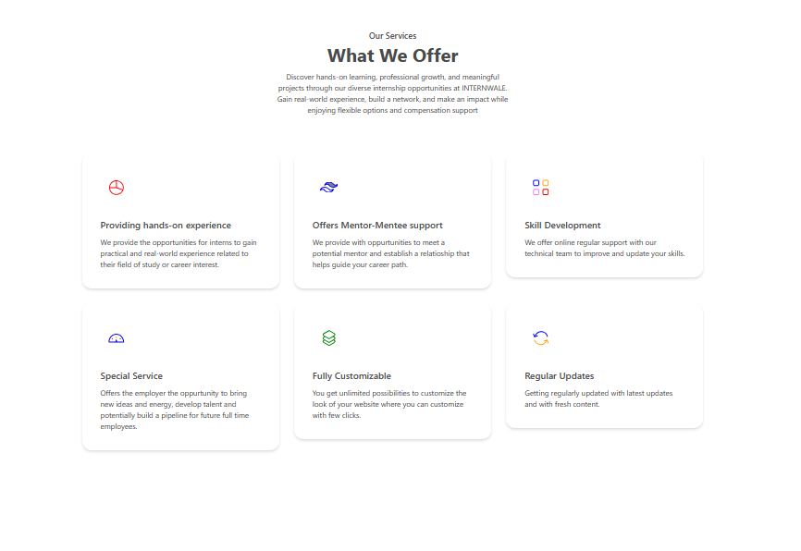
Premium services page

Slide 6
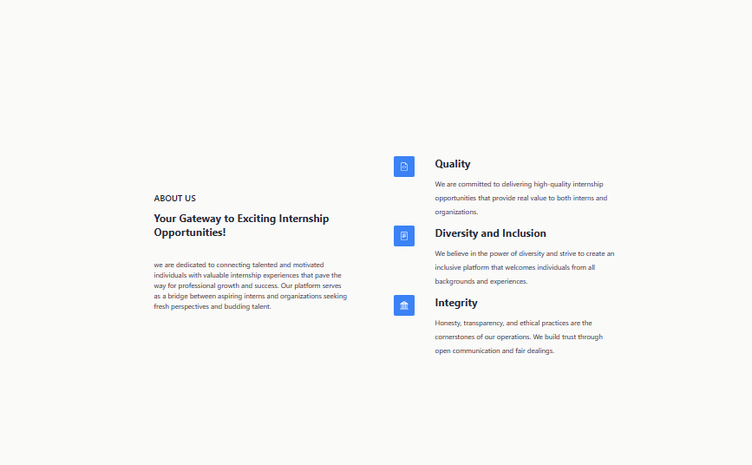
About us

Slide 7
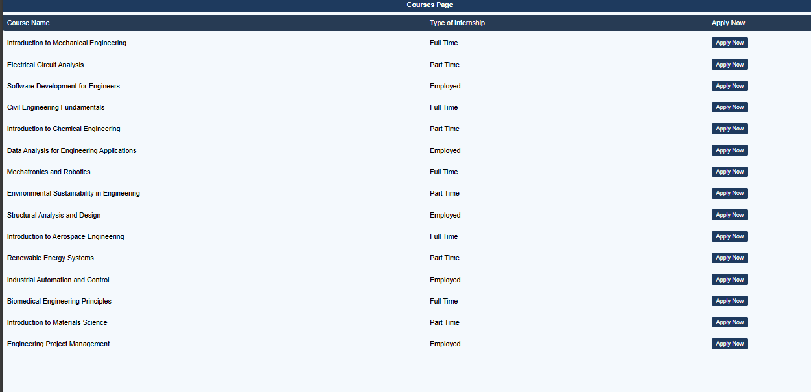
Courses page

Slide 8
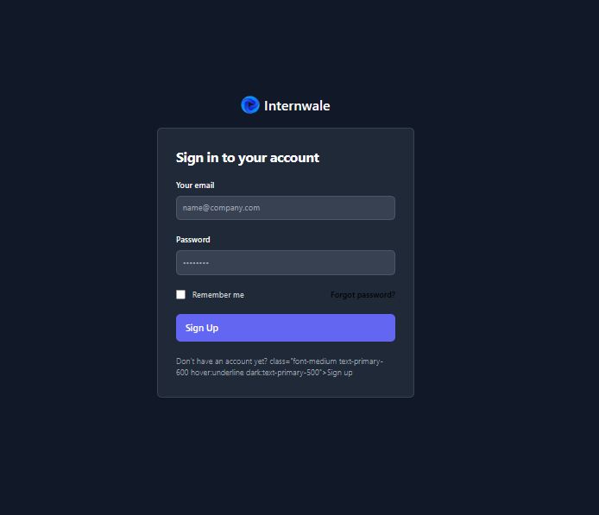
Login

Slide 9
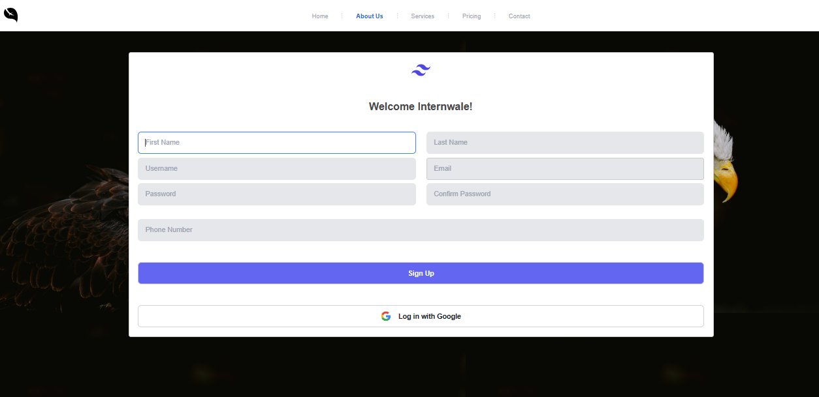
Register/Sign up page

Slide 10
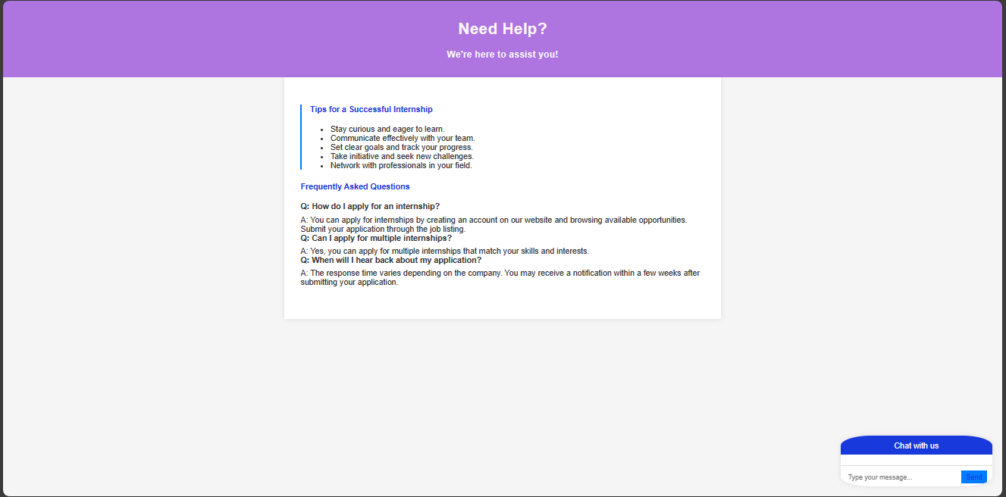
Help page

Slide 11
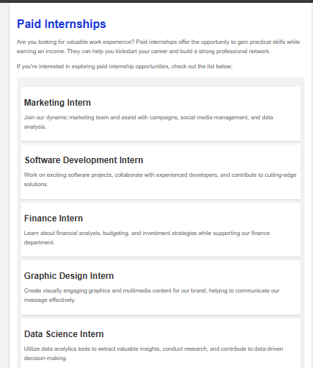
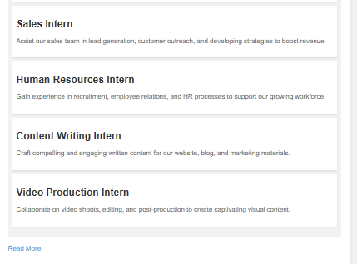
Paid internships page

Slide 12
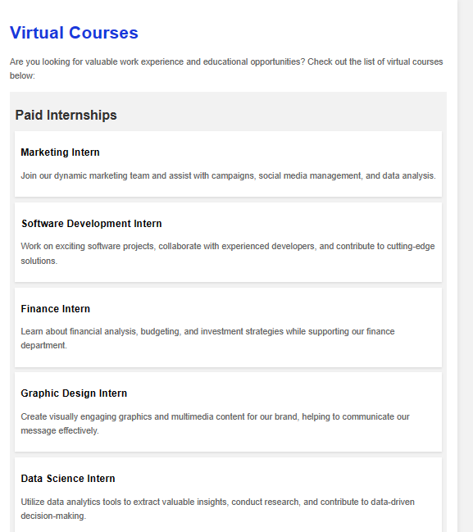
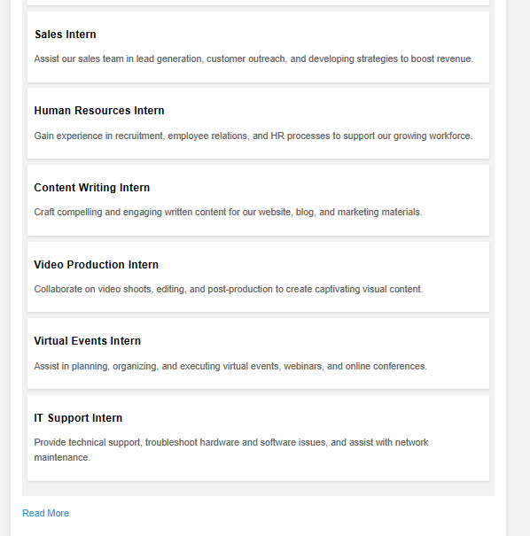
Virtual courses page

Slide 13
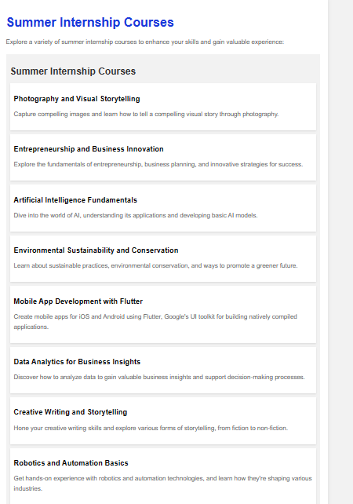
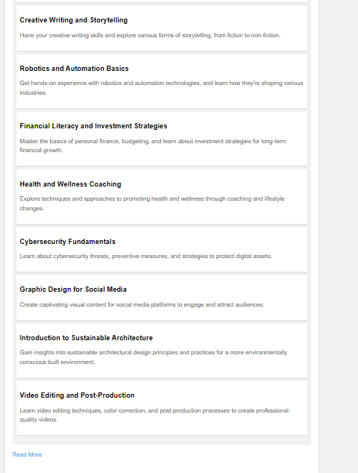
Summer internship courses page

Slide 14
Thank you

